Slide 1
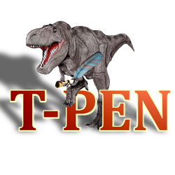
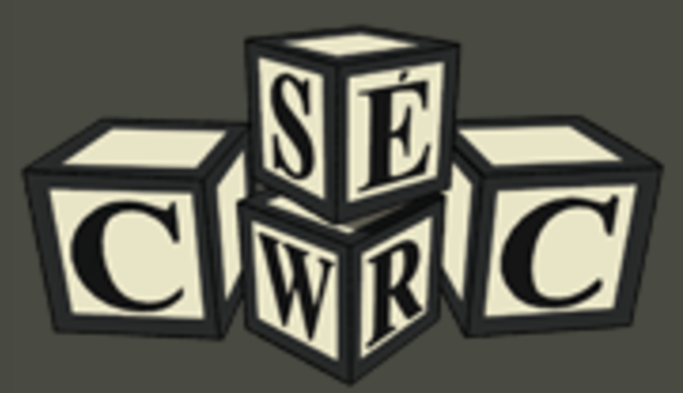
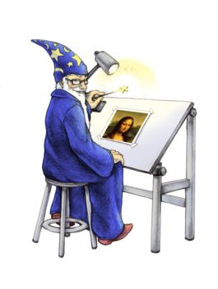

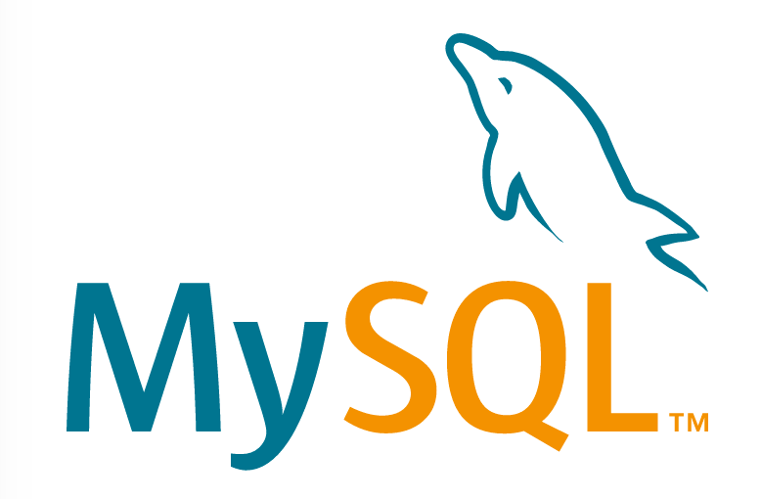


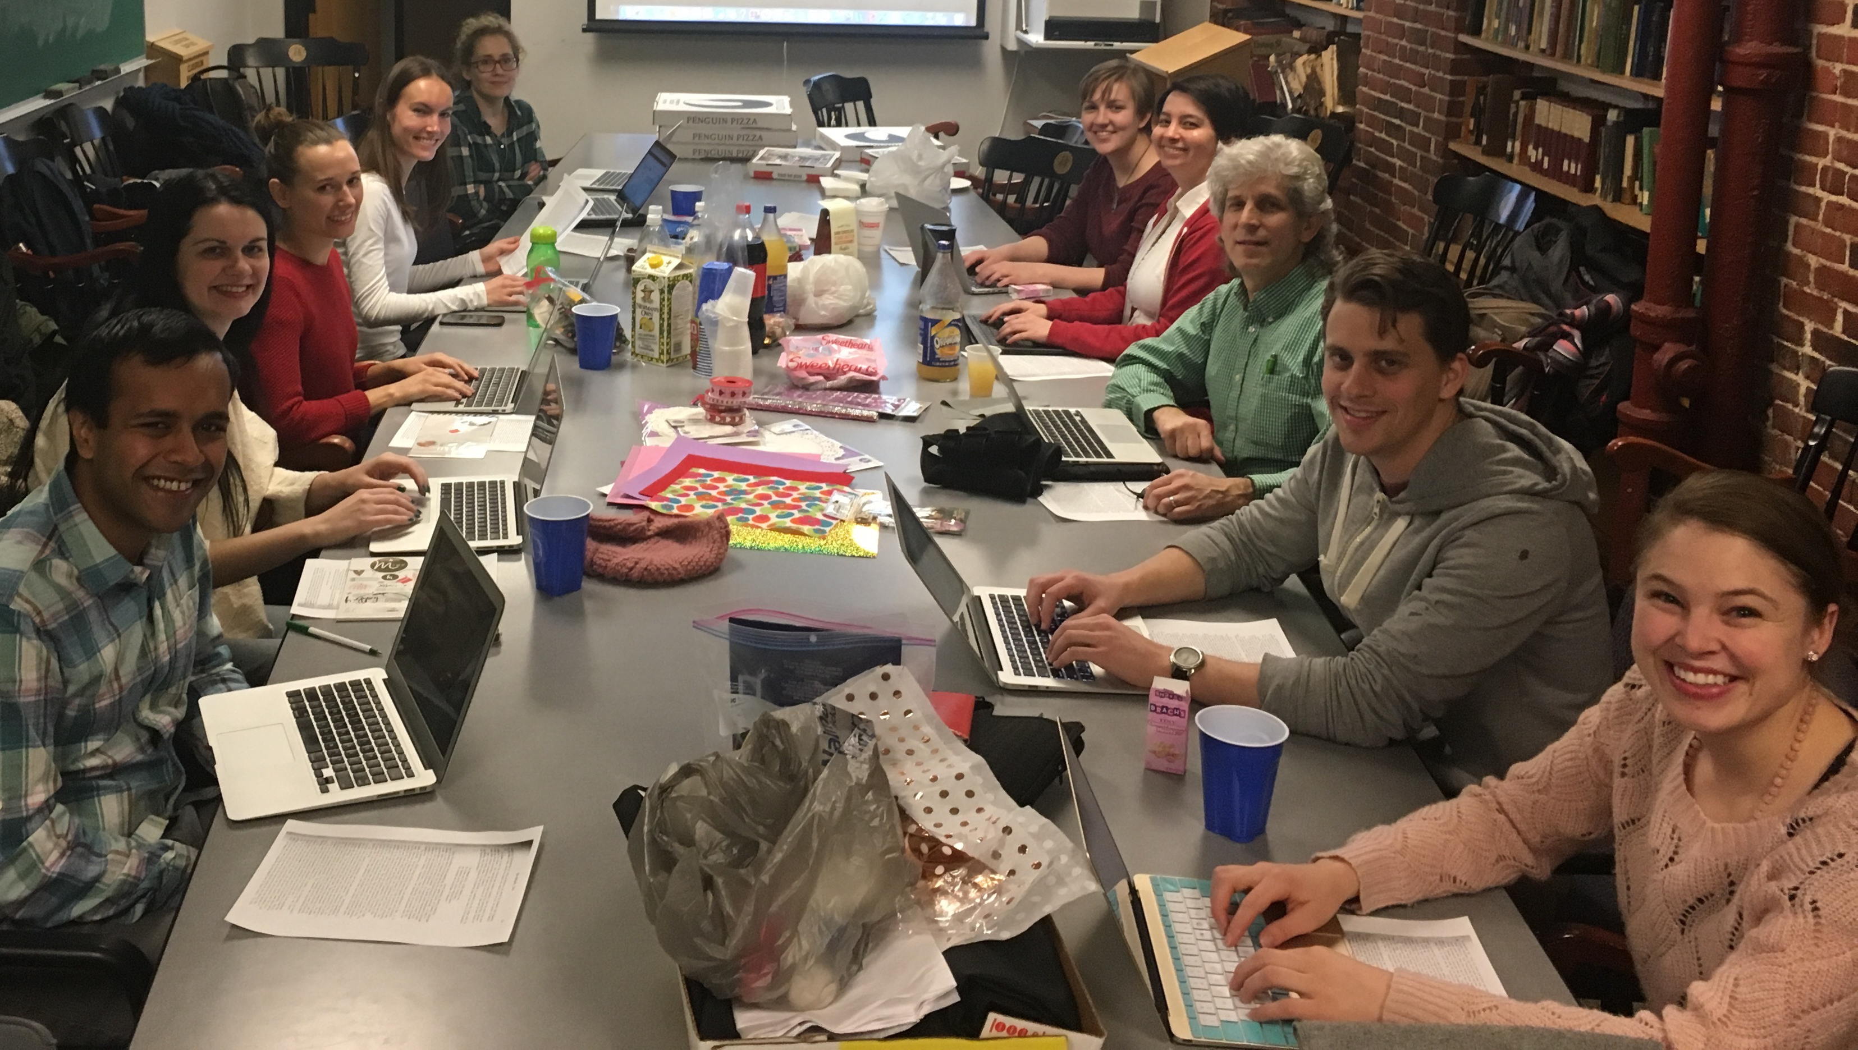
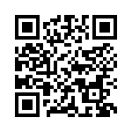
Sarah Sweeney, sj.sweeney@northeastern.edu
Northeastern University Libraries
Digital Scholarship Group
115
Charon: A Repository for Digital Humanities Projects
Components
How can Hydra be used to enable the creation, curation, dissemination, and long-term support of digital humanities (DH) projects and publications? NUL's Digital Scholarship Group seeks to answer this question by using Hydra to develop Charon, a digital curation framework that provides project teams with tools to perform common DH research tasks, including cataloging, text encoding, transcription, and translation.
Editorial Tools
System: Charon
Infrastructure
Kakadu
In Charon, team members are assigned roles and have access to project tasks, which are performed using open source editorial tools embedded in a web interface. Workflows, tools, and task procedures are configured by the project administrator.
Tool
Role
Task
Interface
Tool
Workflows and Interfaces
Role
Task
Interface
Tool
Configure
Submit
Edit
Publish
Curate data
Define workflow
Deposit files
Create metadata
Catalog
Encode
Transcribe
Translate
Design
Build
✏️ Editors
Contribute files and metadata
Claim and execute tasks
Accept and reject deposits
🗄 Depositors
Contribute files and metadata
💡 Creators
Contribute files and metadata
Claim and execute tasks
User Roles
🛠 Administrator(s)
Contribute files and metadata
Claim and execute tasks
Accept and reject deposits
Configure tasks and workflows
Bulk review and file processing
Manage users
You!
This project is still in development and we would like your input! Scan the QR code on the right or visit https://goo.gl/PT1IhE to review and comment on the Charon technical specification. Any and all feedback is welcome!

